Slide 1
MODULE-4 Sequential logic circuits: Flip-flops- SR, JK, T and D. Triggering of flip-flops- Master slave flip- flops, Edge- triggered flip- flops. Excitation table and characteristic equation. Registers- register with parallel load. Counter design: Asynchronous counters- Binary and BCD counters, timing sequences and state diagrams. Synchronous counters- Binary Up- down counter, BCD counter.

Slide 2
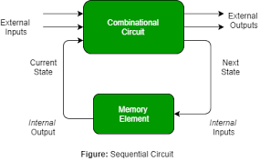
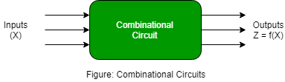
Comparison between combinational and sequential circuits
combinational circuits
Sequential circuits

Slide 3
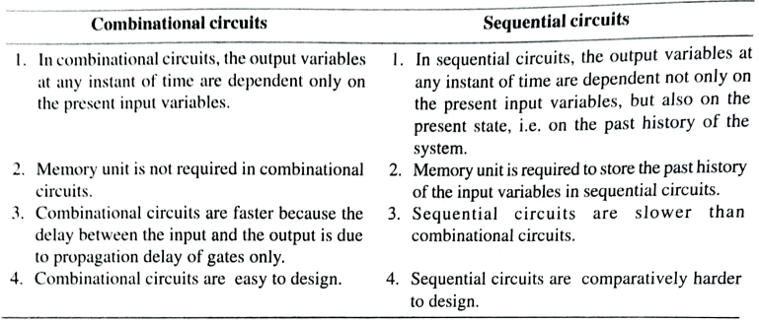
Comparison between combinational and sequential circuits
Example:MUX,Adder,Decoder etc
Example:Counters,Registers etc

Slide 4
The sequential circuits may be classified as synchronous sequential circuits and asynchronous sequential circuits depending on the timing of their signals.
The sequential circuits in which all the FF’s are controlled by same clock are called synchronous sequential circuits.
These circuits will be active only when same clock signal is present to all the flipflops.
The sequential circuits in which all the FF’s are not controlled by a same clock are called asynchronous sequential circuits, i.e. the sequential circuits in which events can take place any time the inputs are applied are called asynchronous sequential circuits. Same clock signal is not given to all the flipflops.

Slide 5
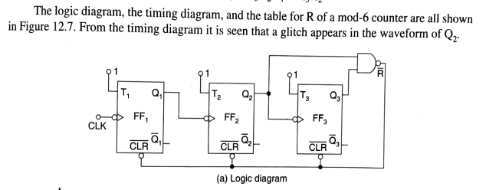
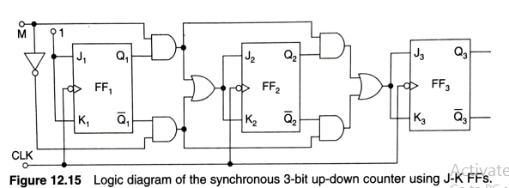
Example: Asynchronous sequential circuits
See how the clk or clock is connected
Example: Synchronous sequential circuits

Slide 6
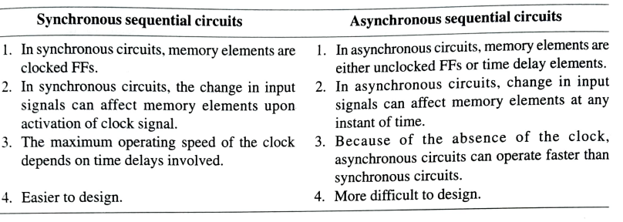

Slide 7
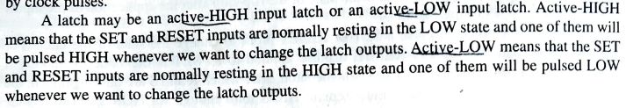
Latches are not mentioned in your syllabus; But latches are the basic element in the flip-flops;
Study flip-flops thoroughly first after that just go through latches and flip-flop comparisons.
Latches
Latches are basic storage elements that operate with signal levels (rather than signal transitions). Latches controlled by a clock transition are flip-flops. Latches are level-sensitive devices.

Slide 8
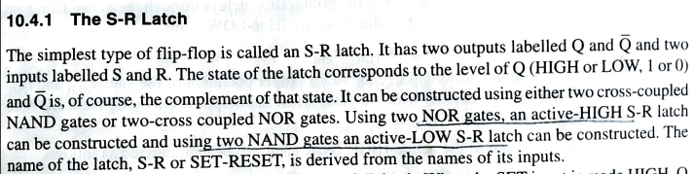

Slide 9
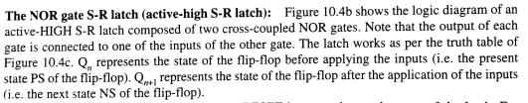

Slide 10
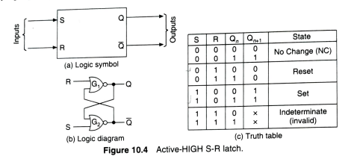
Active HIGH SR Latch

Slide 11
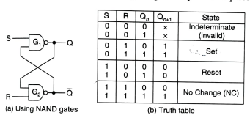
Active LOW SR Latch
An active low SR latch (or active low SR Flip Flop) is a type of latch which is SET when S = 0(LOW). An active low SR latch is typically designed by using NAND gates. The logical circuit for a SR latch is shown below.

Slide 12
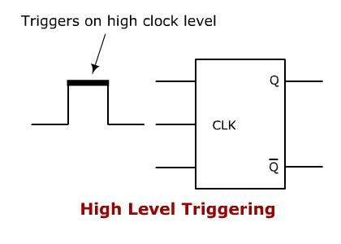
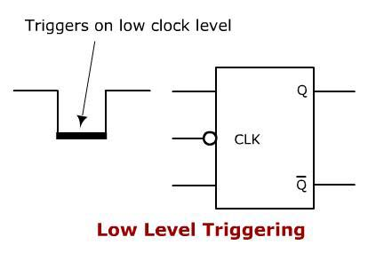
Gated Latches
A controlling signal can be connected at the input of the latch. Here enable (EN) signal is connected at the input using another set of logic gates.
The S and R inputs can be fed to the latch section only when EN = HIGH or ‘logic 1’.
Latches are level triggered
S
EN
R
S
EN
R

Slide 13
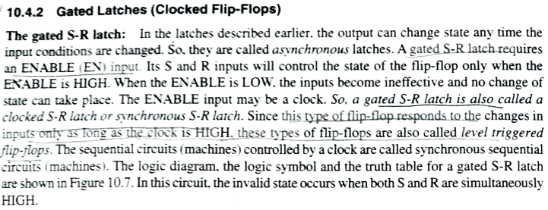

Slide 14
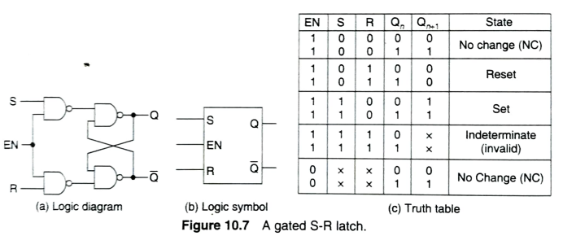

Slide 15
Comparison between Flipflop and Latch
SNo | Flip-flop | Latch
1 | Flip-flop is a bistable device i.e., it has two stable states that are represented as 0 and 1. | Latch is also a bistable device whose states are also represented as 0 and 1.
2 | It checks the inputs but changes the output only at times defined by the clock signal or any other control signal. | It checks the inputs continuously and responds to the changes in inputs immediately.
3 | It is a edge triggered device. | It is a level triggered device.
4 | Gates like NOR, NOT, AND, NAND are building blocks of flip flops. | These are also made up of gates.

Slide 16
Continued…
SNo | Flip-flop | Latch
5 | They are classified into asynchronous or synchronous flipflops. | There is no such classification in latches.
6 | It forms the basic building blocks of many sequential circuits like counters. | These can be used for the designing of sequential circuits but are not generally preferred.
7 | a, Flip-flop always have a clock signal | latche doesn’t have a clock signal
8 | Flip-flop can be build from Latches | Latches can be build from gates
9 | ex:D Flip-flop, JK Flip-flop | ex:SR Latch, D Latch

Slide 17
Triggering of Flip Flops
There are mainly four types of pulse-triggering methods. They differ in the manner in which the electronic circuits respond to the pulse. They are HIGH Level Triggering, LOW Level Triggering, POSITIVE edge triggering and NEGATIVE edge triggering.
1. High Level Triggering
When a flip flop or a sequential circuit is required to respond at HIGH level of clock input, a HIGH level triggering method is used.

Slide 18
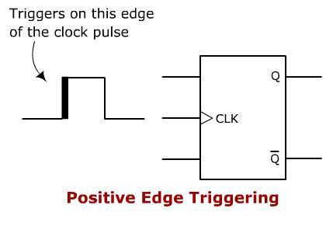
2. Low Level Triggering
When a flip flop or a sequential circuit is required to respond at LOW level of clock input, a LOW level triggering method is used.
It is mainly identified from the clock input lead along with a low state indicator bubble
3. Positive Edge Triggering
When a flip flop is required to respond at a LOW to HIGH transition state, POSITIVE edge triggering method is used. It is mainly identified from the clock input lead along with a triangle.

Slide 19
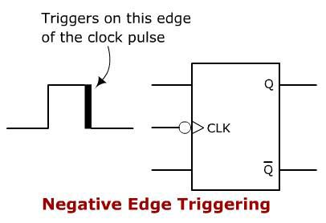
4. Negative Edge Triggering
When a flip flop is required to respond during the HIGH to LOW transition state, a NEGATIVE edge triggering method is used.. It is mainly identified from the clock input lead along with a low-state indicator and a triangle.

Slide 20
Types of flip flops (Edge triggered flip flops)
There are basically four different types of flip flops :
1. Set-Reset (SR) flip-flop
2. JK (Jack Kilby)flip-flop
3. D (Data or Delay) flip-flop
4. T (Toggle) flip-flop

Slide 21
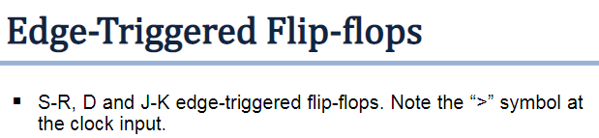
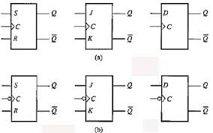
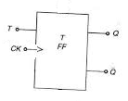



Slide 22
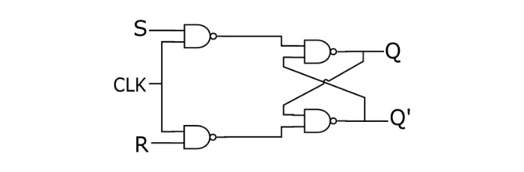
Set-Reset or S-R Flip-flop
This is the simplest flip-flop circuit. It has a set input (S) and a reset input (R). When in this circuit when S is set as active, the output Q would be high and the Q’ will be low. If R is set to active then the output Q is low and the Q’ is high. Once the outputs are established, the results of the circuit are maintained until S or R get changed, or the power is turned off.
Truth table of S-R flip-flop
S | R | Q | State
0 | 0 | 0 | No Change
0 | 1 | 0 | Reset
1 | 0 | 1 | Set
1 | 1 | X | Invalid
Circuit diagram of S-R flip-flop

Slide 23
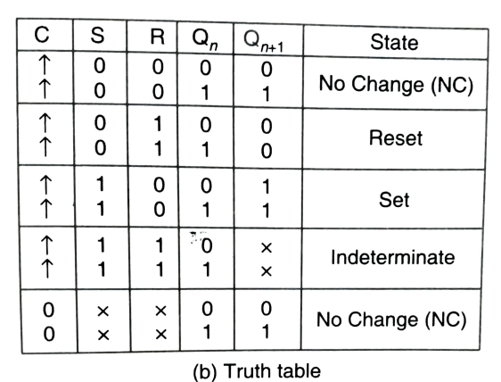

Slide 24
Working of positive edge triggered S-R FF
Table gives the truth table for positive edge triggered S-R flip-flop. The S and R inputs of the flip-flop are synchronous control input as the output changes with respect to the input only on the positive edge of the clock pulse.
When there is no clock pulse or even at the trailing edge (shown in red dotted line of figure 1) then S and R inputs have no effect on the output.
However at the positive edge/leading edge of the clock the flip-flop become active and follows the change in S and R input.
When S is high and R is low then the output goes HIGH at the positive edge of the clock pulse and SET the flip-flop.
When S is low and R is high then the output goes LOW at the positive edge of the clock pulse and RESET the flip-flop.
When both the inputs are low the output retains its previous state and observes no change, at the leading edge of the clock pulse. When both inputs are high the flip-flop is in forbidden state or invalid state.

Slide 25
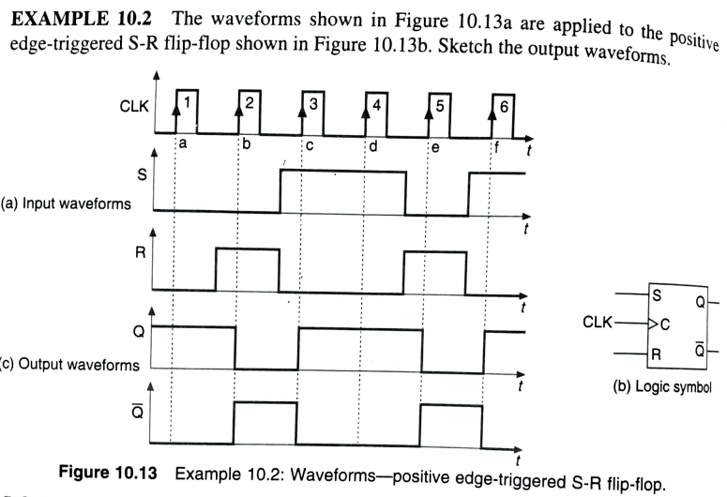

Slide 26
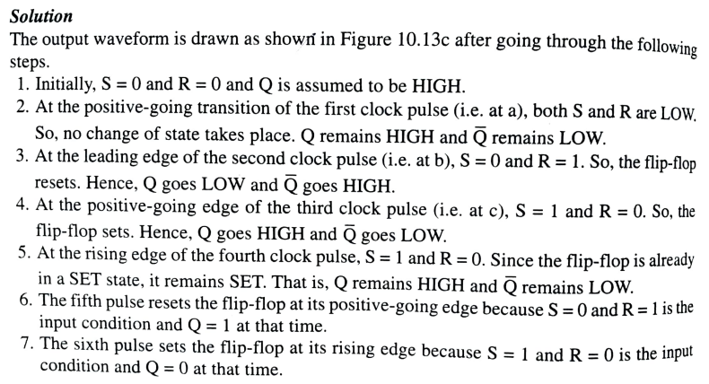

Slide 27
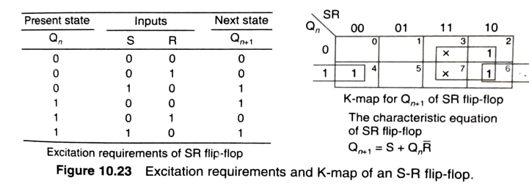

Slide 28
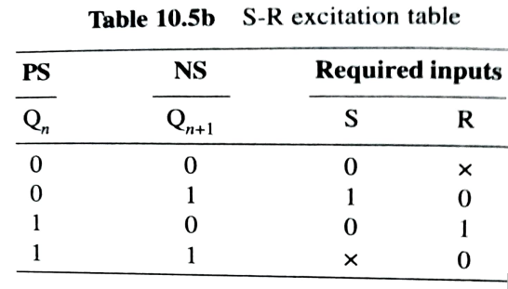
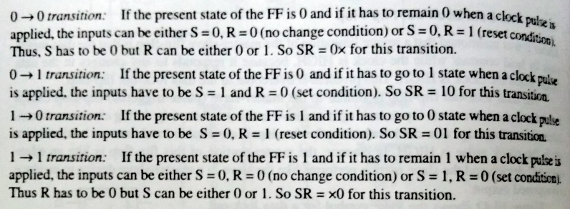

Slide 29
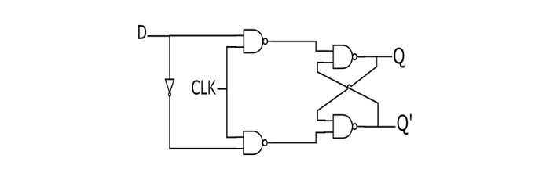
D Flip-flop
In a D flip-flop, the output can only be changed at positive or negative clock transitions, and when the inputs changed at other times, the output will remain unaffected. The D flip-flops are generally used for shift-registers and counters. The change in output state of D flip-flop depends upon the active transition of clock. The output (Q) is same as input and changes only at active transition of clock
Truth table of D flip-flop
D | Q
0 | 0
1 | 1
Circuit diagram of D flip-flop

Slide 30
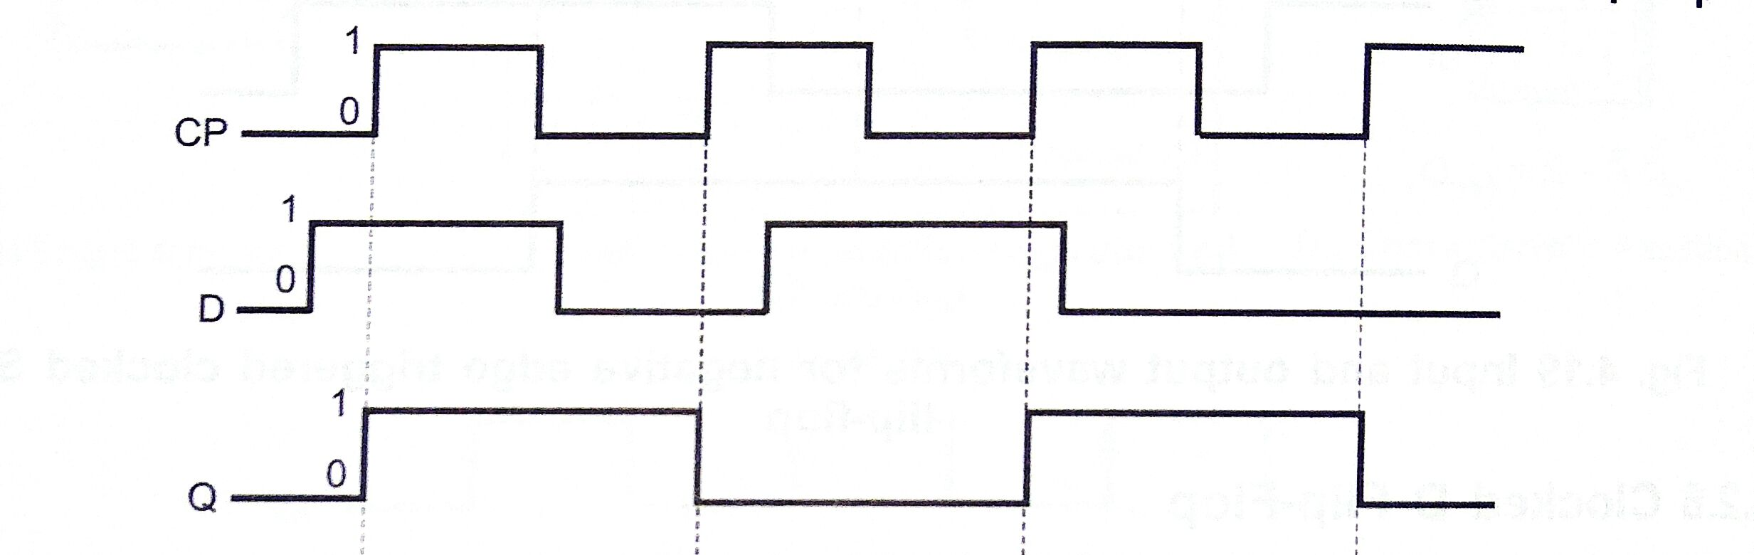
Waveform
CLK
Working
In D flip flop, the single input "D" is referred to as the "Data" input. When the data input is set to 1, the flip flop would be set ie Q=1 , and when it is set to 0, the flip flop would change and become reset ie Q=0. When the clock input is set to true, the D input condition is only copied to the output Q.

Slide 31
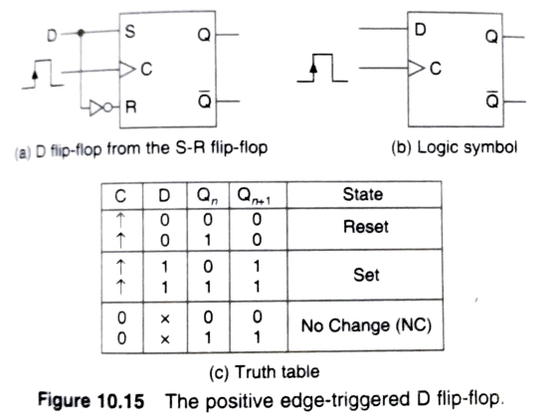

Slide 32
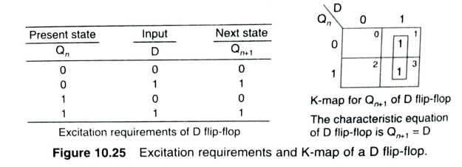
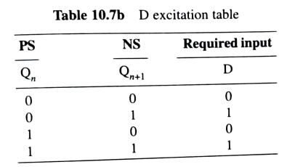

Slide 33
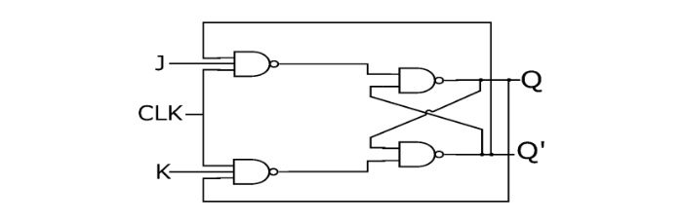
J-K Flip-flop (The JK Flip Flop name has been kept on the inventor name of the circuit known as Jack Kilby)
Because of the invalid state corresponding to S=R=1 in the SR flip-flop, there is a need of another flip-flop. The JK flip-flop operates with only positive or negative clock transitions. The operation of the JK flip-flop is similar to the SR flip-flop. When the input J and K are different then the output Q takes the value of J at the next clock edge. When J and K both are low then NO change occurs at the output. If both J and K are high, then at the clock edge, the output will toggle from one state to the other.
Truth table of JK flip-flop
J | K | Q | State
0 | 0 | 0 | No Change
0 | 1 | 0 | Reset
1 | 0 | 1 | Set
1 | 1 | Toggles | Toggles
Circuit diagram of JK flip-flop

Slide 34
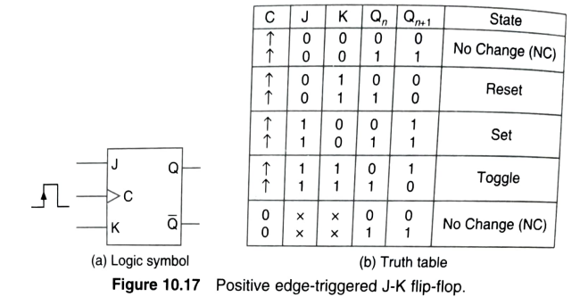

Slide 35
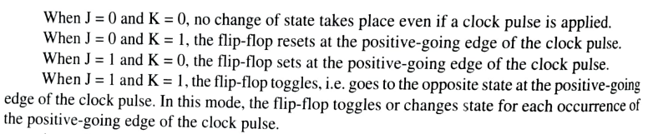

Slide 36
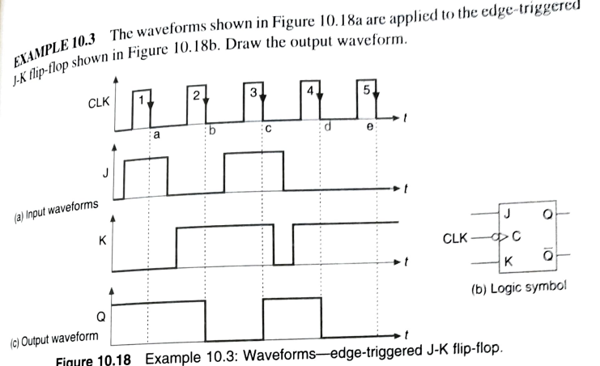

Slide 37
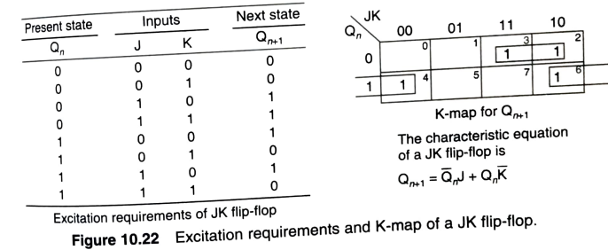

Slide 38
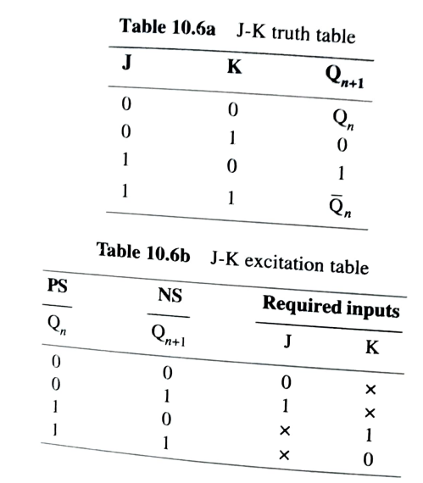

Slide 39
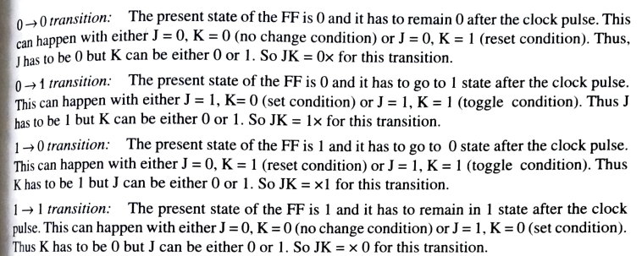

Slide 40
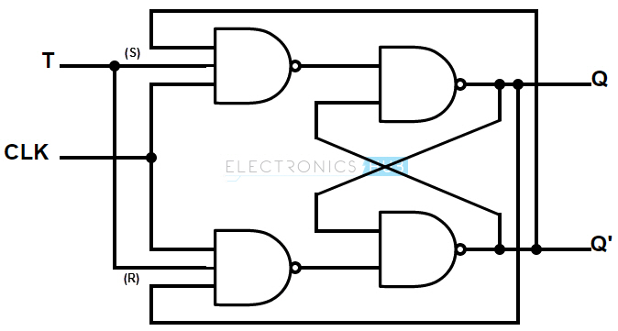
T Flip-flop
A T flip-flop (Toggle Flip-flop) is a simplified version of JK flip-flop. The T flop is obtained by connecting the J and K inputs together. The flip-flop has one input terminal and clock input. These flip-flops are said to be T flip-flops because of their ability to toggle the input state. Toggle flip-flops are mostly used in counters.
Truth Table of T flip-flop
T | Q(t) | Q(t+1)
0 | 0 | 0
0 | 1 | 1
1 | 0 | 1
1 | 1 | 0
Circuit diagram of T flip-flop

Slide 41
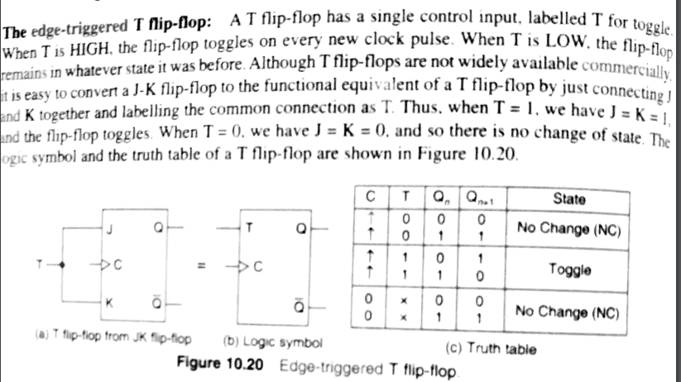

Slide 42
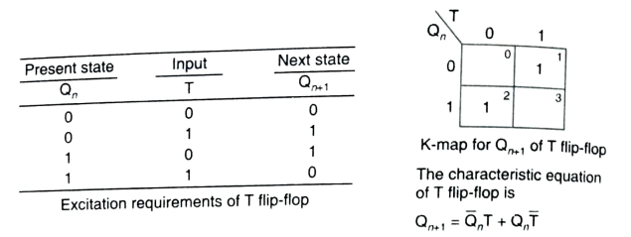
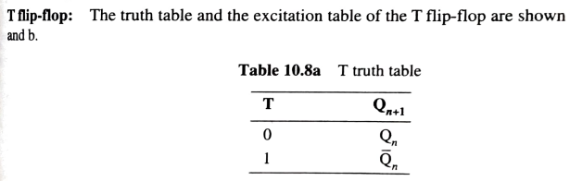
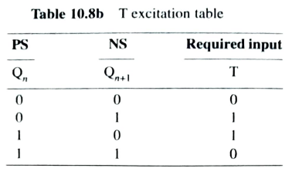

Slide 43
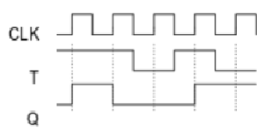

Slide 44
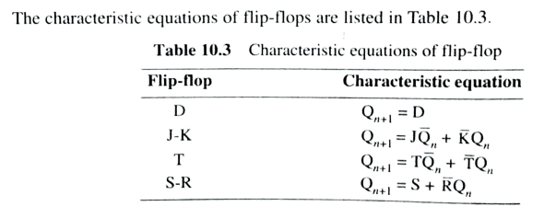

Slide 45
Race Around Condition
Race Around Condition In JK Flip-flop –
In level triggered or pulse triggered JK Flip-flop,For J-K flip-flop, if J=K=1, and if clk=1 for a long period of time, then Q output will toggle as long as CLK is high, which makes the output of the flip-flop unstable or uncertain.
This problem is called race around condition in J-K flip-flop. This problem (Race Around Condition) can be avoided by ensuring that the clock input is at logic “1” only for a very short time. This introduced the concept of Master Slave JK flip flop.

Slide 46
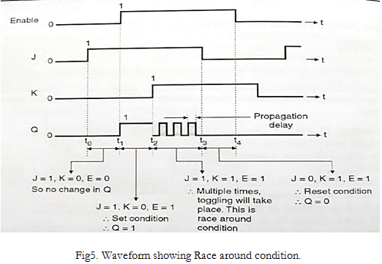
t_{p}
or clock
t

Slide 47
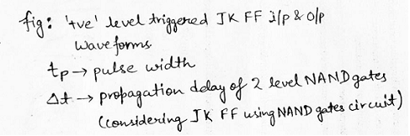
This problem was present in the level triggered or pulse triggered JK Flip-flop.
There are three ways using which we can eliminate the race around condition in JK flip flop, which are discussed below:
Race around condition exists when t_{p} ≥ Δt. Thus, by keeping t_{p} < Δt, we can avoid race around condition.
Use of edge triggering in flip flops.
By using a master-slave flip-flop.

Slide 48
Master Slave JK flip flop –
The Master-Slave Flip-Flop is basically a combination of two JK flip-flops connected together in a series configuration.
Out of these, one acts as the “master” and the other as a “slave”. The output from the master flip flop is connected to the two inputs of the slave flip flop whose output is fed back to inputs of the master flip flop.
In addition to these two flip-flops, the circuit also includes an inverter.

Slide 49
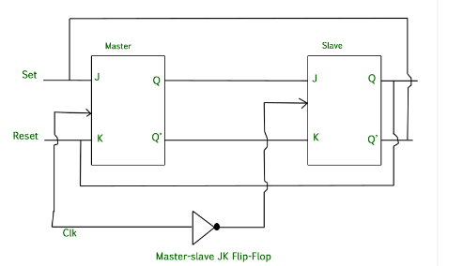
The inverter is connected to clock pulse in such a way that the inverted clock pulse is given to the slave flip-flop. In other words if Clk=0 for a master flip-flop, then Clk=1 for a slave flip-flop and if Clk=1 for master flip flop then it becomes 0 for slave flip flop.
CLK

Slide 50
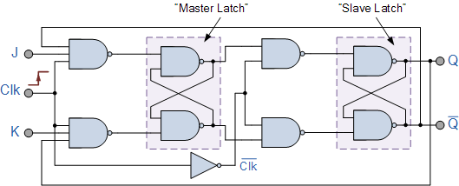
Logic diagram of Master Slave JK FF

Slide 51


Slide 52
Working of a master slave flip flop –
When the clock pulse goes to 1, the slave is isolated; J and K inputs may affect the state of the system. The slave flip-flop is isolated until the Clk goes to 0.
When the Clk goes back to 0, information is passed from the master flip-flop to the slave and output is obtained.
Firstly the master flip flop is positive level triggered and the slave flip flop is negative level triggered, so the master responds before the slave.
If J=0 and K=1;Q=0 and Q’ =1; Q and Q’ output of the master goes to the J and K inputs of the slave and the clock forces the slave to reset, thus the slave copies the master.
If J=1 and K=0; Q=1 and Q’ =0; Q and Q’ output of the master goes to the J K inputs of the slave at the Negative transition of the clock , again the slave copies the master.
If J=1 and K=1, it toggles on the positive transition of the clock and thus the slave toggles on the negative transition of the clock.
If J=0 and K=0, the flip flop is disabled and Q remains unchanged.

Slide 53

Asynchronous Inputs

Slide 54


Slide 55


Slide 56


Slide 57



Slide 58


Slide 59


Slide 60

Counters

Slide 61


Slide 62



Slide 63


Slide 64


Slide 65


Slide 66


Slide 67

2 bit negative edge triggered up-down counter

Slide 68
We have discussed 3 bit up-down counter in class…for n bit counter-you have to use n FFs.
I have shared the materials of 3 bit up-down counter in whatsapp.
Study asynchronous counter using negative edge triggered thoroughly , after that study the changes that have to be made for counters using positive edge triggered FF.

Slide 69


Slide 70



Slide 71


Slide 72
The modulus of a counter is the number of states in its count sequence. The maximum possible modulus is determined by the number of flip-flops.
For example, a four-bit counter can have a modulus of up to 16 (2^4).We can call it as MOD-16 counter.
ie,by using n FFs,2^{n} states can be counted.
So a 3 flip-flop counter will have a maximum count of 2³ = 8 counting states and would be called a MOD-8 counter.

Slide 73


Design of Asynchronous Counters

Slide 74


Slide 75


Slide 77


Slide 78



Slide 79


Slide 80


Slide 81



Slide 82


Slide 83



Slide 84

J2
K2

Slide 85


Slide 86


Slide 87


Slide 88


Slide 89



Slide 91


Slide 92


Slide 93



Slide 94


Slide 95
Binary Up- down counter, BCD counter are mentioned in syllabus.
Refer synchronous counters.pdf for various types of synchronous counter design .
Registers- register with parallel load.-is explained along with module 5

